Slide 1
Company Budget Utilization & Efficiency Report
-By Ayonika Dutta

Slide 2
INTRODUCTION
This project aims to develop a budget report along with an automated master data system for management and visualization. Through the system, the report will be capable of reporting employee allocation by project, total budget, delta variations, monthly billing cycles, and the remaining budget ratio. The project aims at simplifying monitoring of the budget by developing a master data sheet that contains the total budget, money spent, and balance of a company. The data sheet will benefit from conditional formatting to alter the rows' background colors to red for less than 10% balance and yellow when the balance is less than 25%.

Slide 3
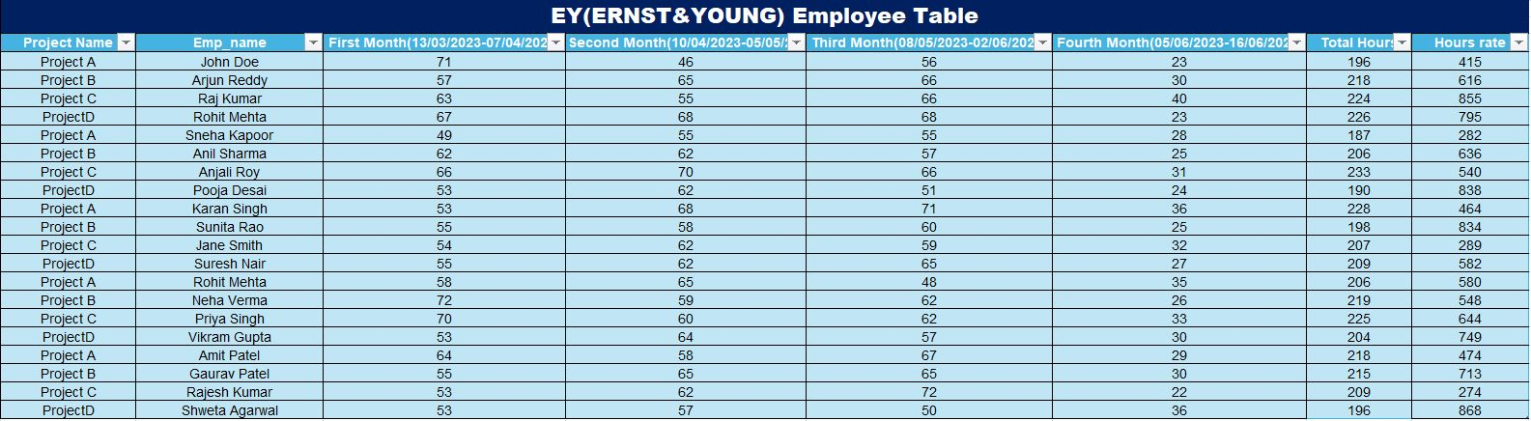
EY(ERNST & YOUNG)

Slide 4
Employee Work-Hour and Budget Analysis of EY
Employee Work-Hour Table Analysis
Projects & Employees: Tracks employee work hours across four projects (A, B, C, and D) over 14 weeks.
Weekly & Monthly Work Hours: Each employee’s work hours are recorded weekly and totaled monthly.
Total Hours & Hourly Rate: Used to determine total labor cost per project.
2. Budget Table Analysis
Employee Count per Project: Each project has 5 employees.
Monthly Burn Rate: Labor costs are tracked per month.
Project-Wise Budget: Fixed at ₹5,000,000 per project.
Total Burnt & Remaining Budget:
Project A: Burnt ₹2,292,525 (54% budget remaining).
Project B: Burnt ₹3,534,432 (29% budget remaining)
Project C: Burnt ₹2,856,996 (43% budget remaining).
Project D: Burnt ₹3,927,800 (21% budget remaining).
3. Key Insights
Project D has the highest spending and only 21% budget left, indicating possible overspending.
Project B has a high burn rate, with only 29% budget left.
Project A is the most cost-efficient, with 54% budget remaining.
Project C has moderate spending, with 43% of the budget left.
4. Recommendations
Monitor Project D & Project B to prevent budget overruns.
Project A has a surplus budget – consider reallocation or optimization.
Redistribute workforce/resources to balance workload and efficiency.

Slide 5
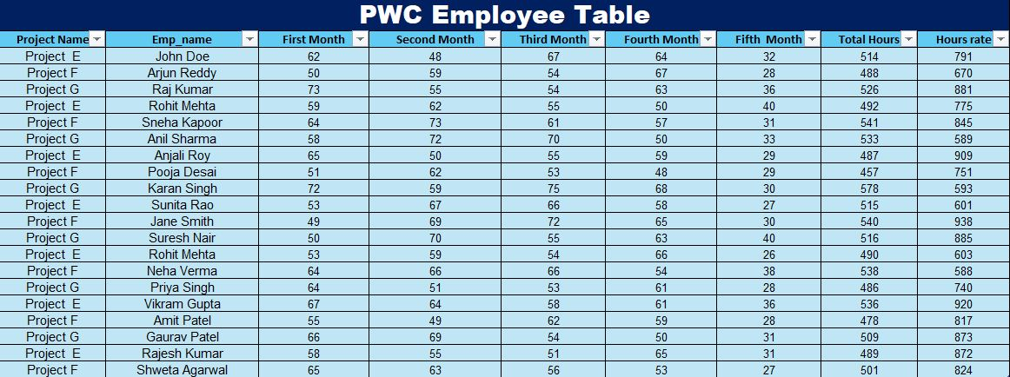
PWC

Slide 6
Employee Work-Hour and Budget Analysis of PWC
1. Employee Work-Hour Table Analysis
Projects Covered: E, F, and G (18 weeks of tracking).
Employee Count:
Project E: 7 employees
Project F: 7 employees
Project G: 6 employees
Work Hours:
Recorded weekly, aggregated monthly.
Costs calculated based on hourly rates.
2. Budget Table Analysis
Total Budget: ₹11,000,000 per project.
Burn Rate & Remaining Budget:
Project E: ₹10,241,712 spent, ₹758,288 left (7%).
Project F: ₹10,197,741 spent, ₹802,259 left (7%).
Project G: ₹7,630,553 spent, ₹3,369,447 left (31%).
3. Key Insights
Projects E & F are close to budget exhaustion (only 7% left).
Project G is more cost-efficient (31% of budget remaining).
Spending was highest in the first four months, then declined.
Projects E & F have the highest burn rate – risk of overspending.
4. Recommendations
Monitor Projects E & F to prevent overspending.
Optimize workforce allocation for efficiency.
Adopt Project G’s cost-efficiency strategies across other projects.

Slide 7
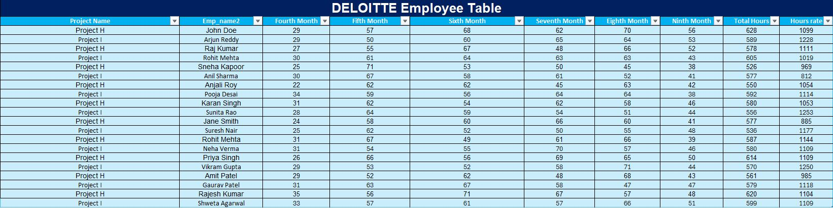
DELOITTE

Slide 8
Employee Work-Hour and Budget Analysis of Deloitte
1. Employee Table Analysis
Employee Count:
Project H: 10 employees
Project I: 10 employees
Work Hours:
Recorded weekly and aggregated monthly.
The total hours worked for each project:
Project H: 6,280 hours
Project I: 5,890 hours
Employees worked consistently across all tracked weeks.
2. Budget Table Analysis
Total Budget per Project: ₹44,600,000
Burn Rate & Remaining Budget:
Project H: ₹32,989,794 spent, ₹11,610,206 left (26% remaining).
Project I: ₹34,898,491 spent, ₹9,701,509 left (22% remaining).
3. Key Insights
Project I is burning through its budget faster than Project H.
Project H has slightly better budget retention (26% remaining vs. 22% in Project I).
Overall, both projects are nearing budget exhaustion, requiring close monitoring.
Spending is highest in months 4 to 7, indicating a peak workload during this period.
Hourly rates and work-hour distribution suggest potential inefficiencies.
4. Recommendations
Monitor Project I closely to prevent premature budget depletion.
Optimize workforce allocation to ensure hours are utilized efficiently.
Adopt cost-saving strategies similar to Project H for better budget retention.

Slide 9
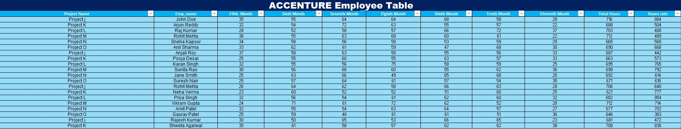
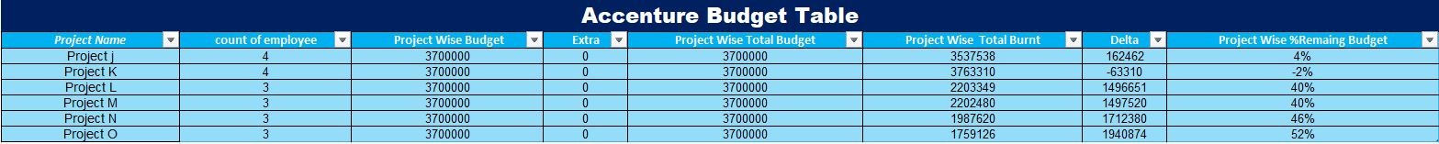
ACCENTURE

Slide 10
Employee Work-Hour and Budget Analysis of Accenture
1. Employee Table Analysis
Employee Count:
Project J: 4 employees
Project K: 4 employees
Project L, M, N, O: 3 employees each
Work Hours:
Recorded weekly, aggregated across multiple months.
Variation in hours worked per employee across projects.
2. Budget Table Analysis
Burn Rate & Remaining Budget:
Project J: ₹3,537,538 spent, ₹162,462 left (4% remaining).
Project K: Overspent by ₹63,310, meaning costs exceeded the budget by 2%.
Project L & M: ₹2,203,349 and ₹2,202,480 spent, with 40% budget remaining.
Project N: ₹1,987,620 spent, 46% budget remaining.
Project O: ₹1,759,126 spent, 52% budget remaining.
3. Key Insights
Projects J & K are at critical budget exhaustion levels (4% and overspent by 2%, respectively).
Projects L, M, N, and O have significant budget retention, with 40-52% remaining.
Project K is at risk of overspending and requires immediate cost containment.
Lower employee count (Projects L, M, N, O) contributes to better budget retention.
4. Recommendations
Immediate Cost Control for Project K to prevent further budget overrun.
Monitor Projects J & K Closely to avoid unnecessary spending.
Reallocate Budget Strategies from Projects O & N (52% & 46% remaining) to J & K.

Slide 11
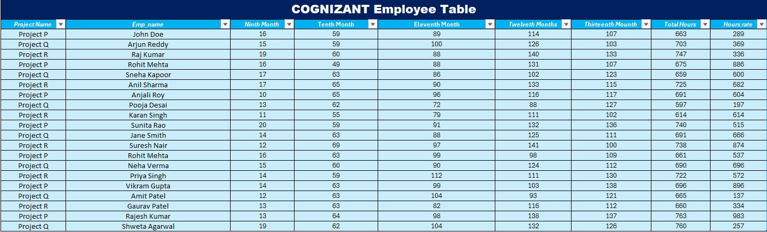
COGNIZANT

Slide 12
Employee Work-Hour and Budget Analysis of Cognizant
1. Employee Analysis
Employee Count:
Project P: 7 employees.
Project Q: 7 employees.
Project R: 6 employees.
Weekly Work Hour Trends:
Work hours are logged weekly over 16 weeks (from Nov 2023 to March 2024).
Employees generally work 10-40 hours per week, with fluctuations per project.
Peak work hours observed in the Eleventh Month (January 2024) across all projects.
Project R has fewer employees but relatively high weekly work hours.
2. Budget Analysis
Burn Rate & Remaining Budget:
Project P: Spent: ₹14,182,770, Remaining: ₹1,697,230 (11% budget left), High burn rate, nearing depletion.
Project Q: Spent: ₹9,016,878, Remaining: ₹6,863,122 (43% budget left), Balanced spending with good remaining funds.
Project R: Spent: ₹9,012,340, Remaining: ₹6,867,660 (43% budget left), Similar trend as Project Q, maintaining budget control.
3. Key Insights & Risk Areas
Projects Q & R are well within budget, with 43% of funds still available.
Project P is at risk, with only 11% of the budget left, requiring urgent cost optimization.
Project R has fewer employees but maintains a comparable budget burn rate to Project Q, indicating higher individual employee costs or overtime.
4. Recommendations
Immediate Budget Monitoring for Project P – Ensure that the remaining funds cover essential tasks.
Cost Optimization Strategies for Project P – Redistribute work or reduce overtime to avoid budget overrun.
Utilize Surplus Budgets from Projects Q & R – If feasible, allocate some remaining funds towards Project P.

Slide 13
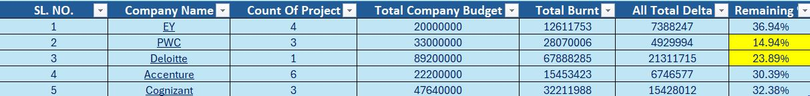
Master Data Sheet

Slide 14
CONCLUSION
The budget report indicates that PWC (14.94%) and Deloitte (23.89%) have the lowest remaining budgets, with PWC being in a critical state. Other companies like EY (36.94%), Accenture (30.39%), and Cognizant (32.38%) have a healthier budget balance. The master data should include employee allocation per project, budget utilization, delta, and monthly billing to track expenses efficiently. Automation with conditional formatting should highlight red for below 10% (critical risk) and yellow for below 25% (warning level) to help in real-time budget monitoring and decision-making to avoid overspending.

Slide 15
THANK YOU

